Slide 1

Stock Price Prediction Using Deep-Learning with RNN and LSTM
2014097081 Cho yoonsang

Slide 2
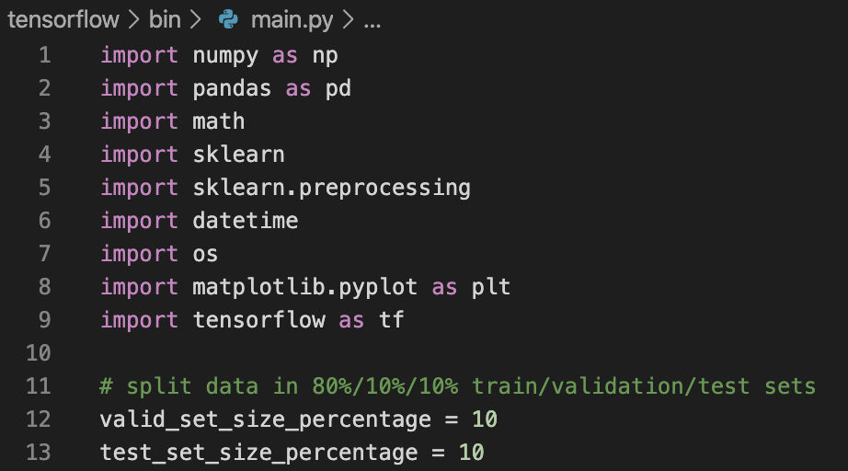
Libraries and settings

Slide 3
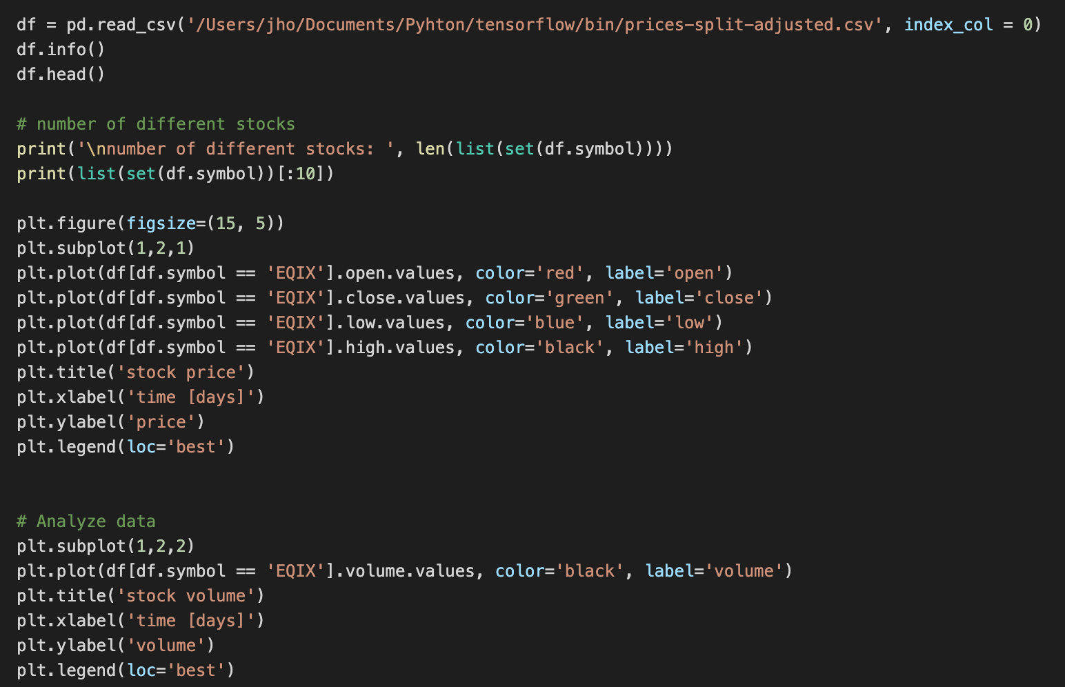
Analyze data
Load stock prices from prices-split-adjusted.csv
Analyze data

Slide 4
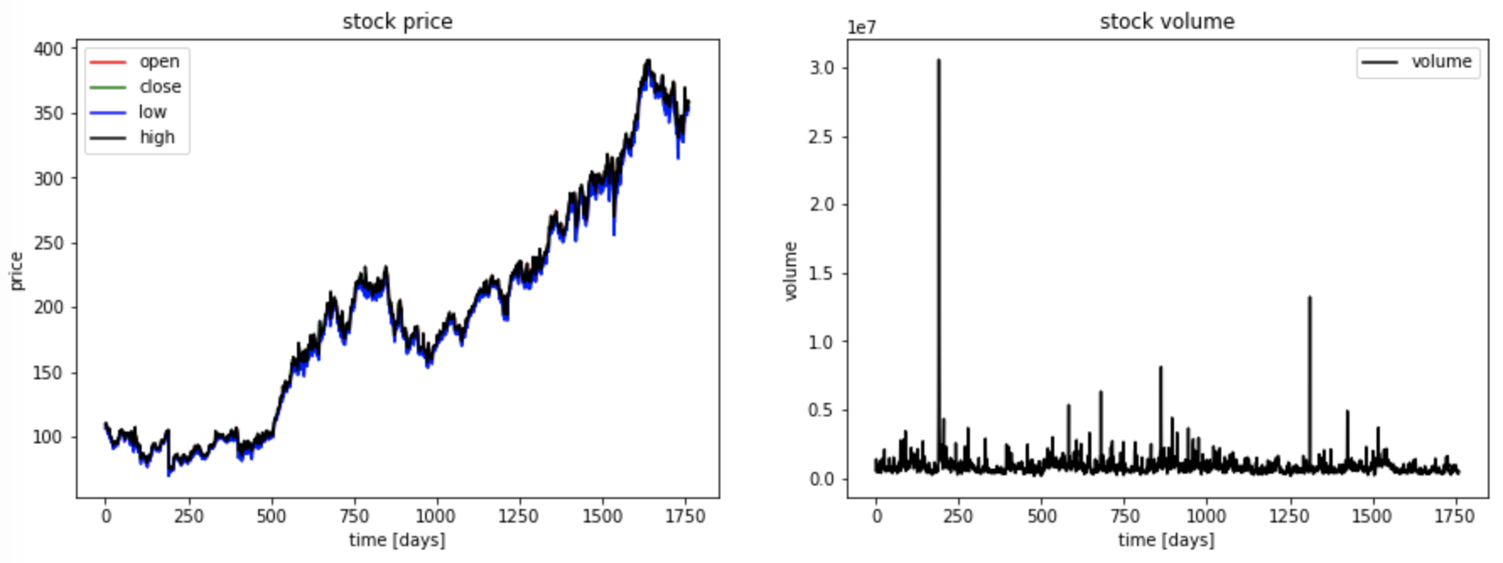
Analyze data

Slide 5
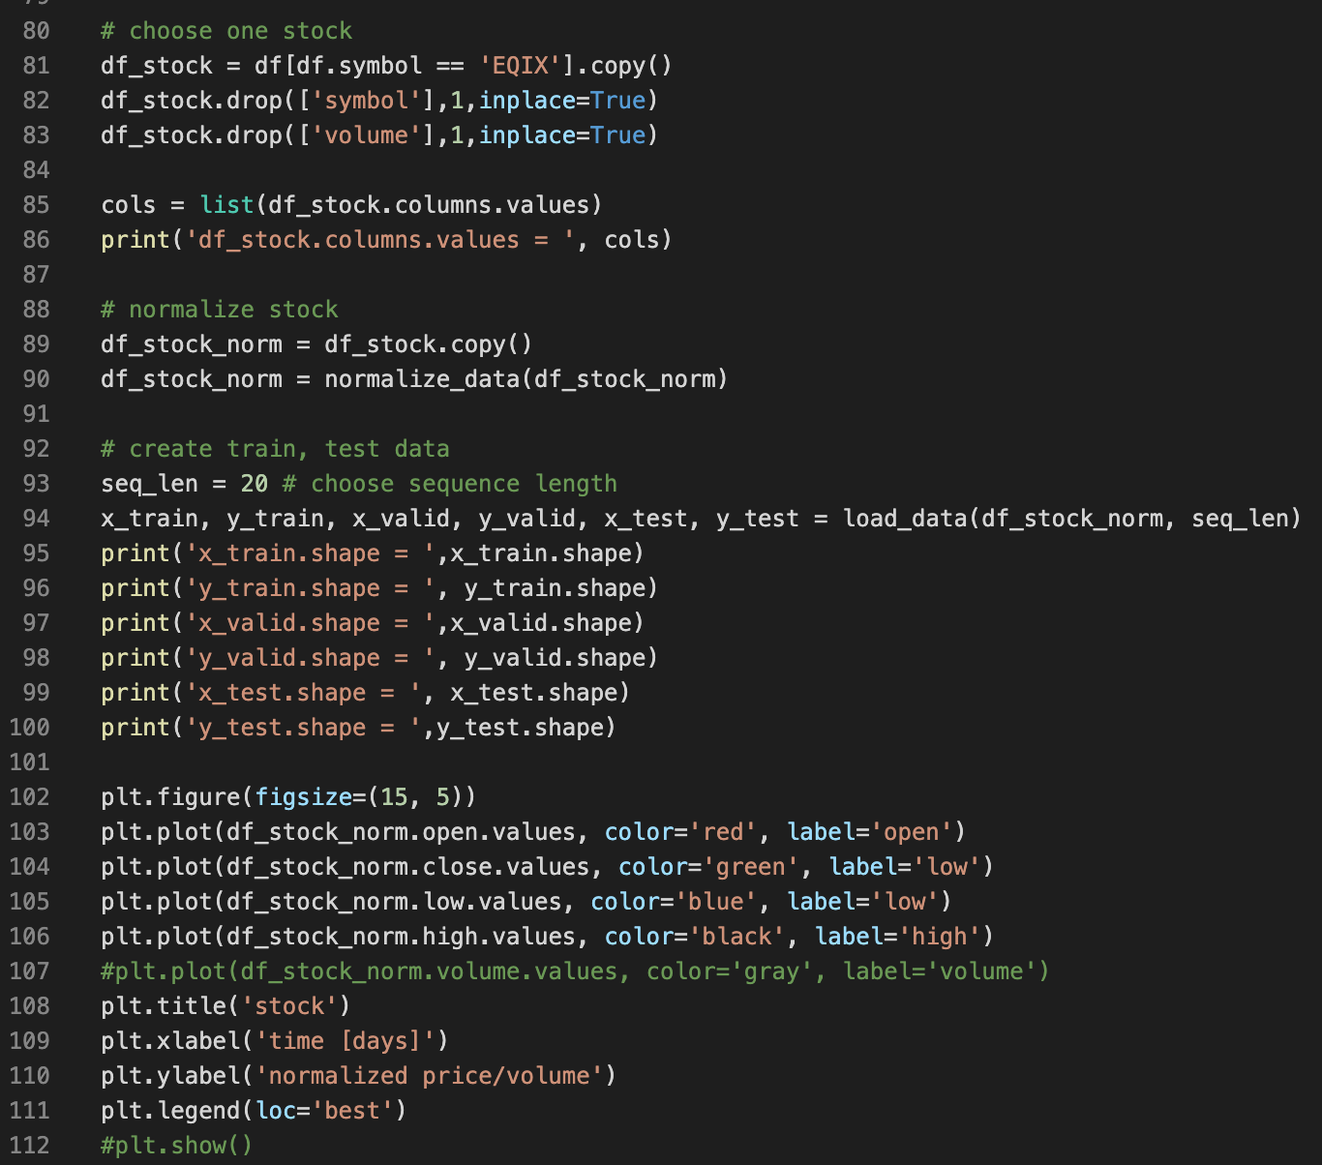
Manipulate data
Choose a specific stock
Drop feature: volume
Normalize stock data
Create train, validation and test data sets

Slide 6
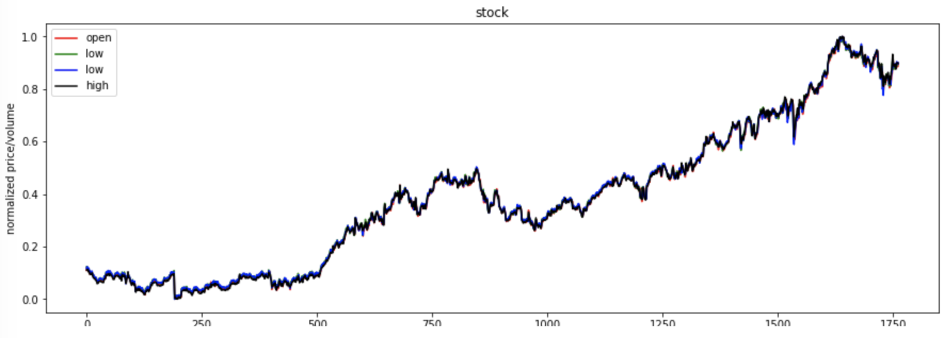
Manipulate data

Slide 7
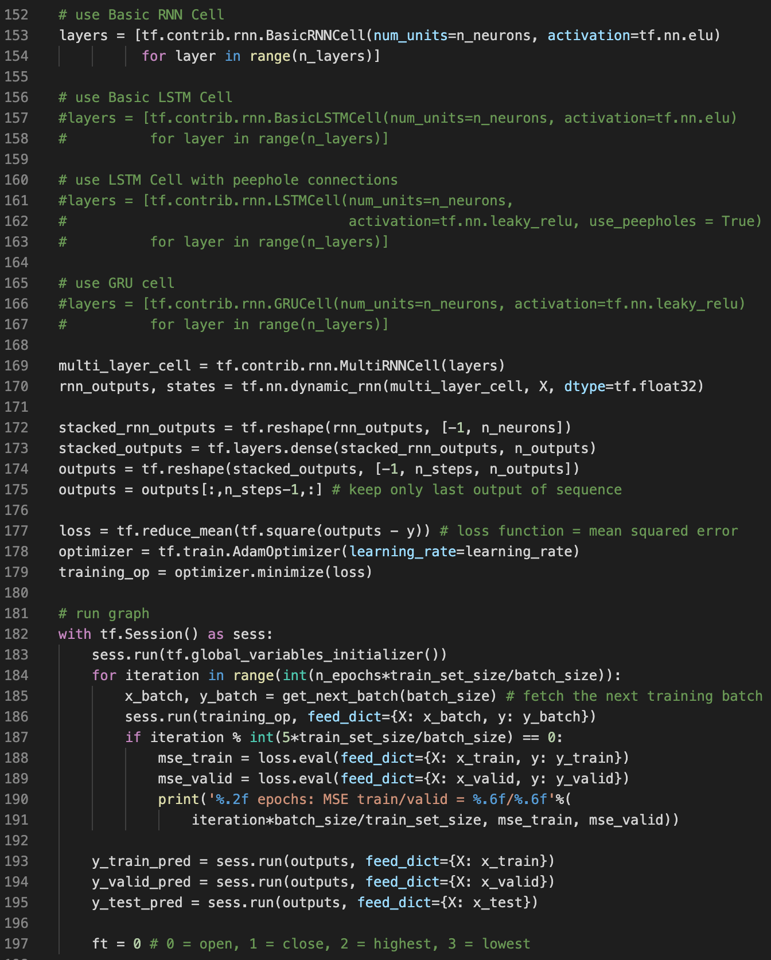
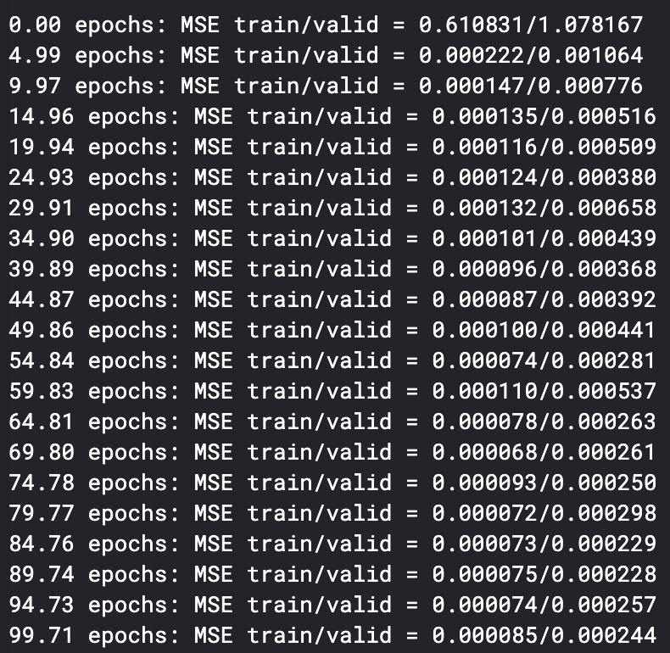
Model and validate data
RNNs with basic, LSTM, GRU cells
Result

Slide 8
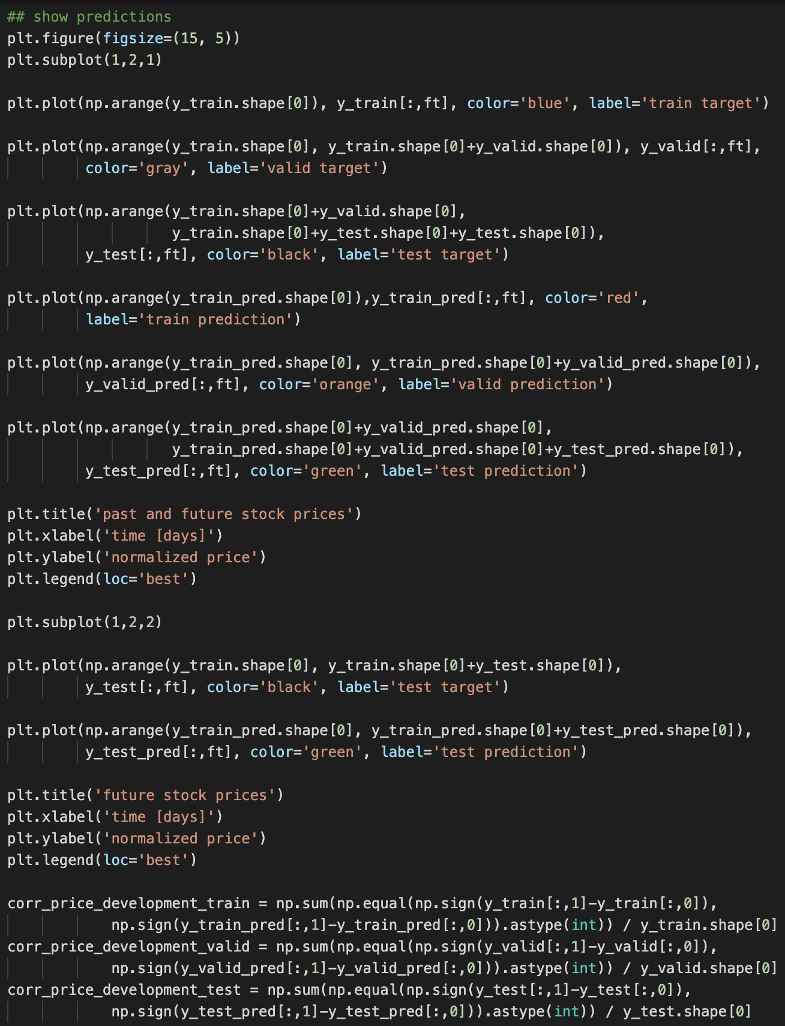
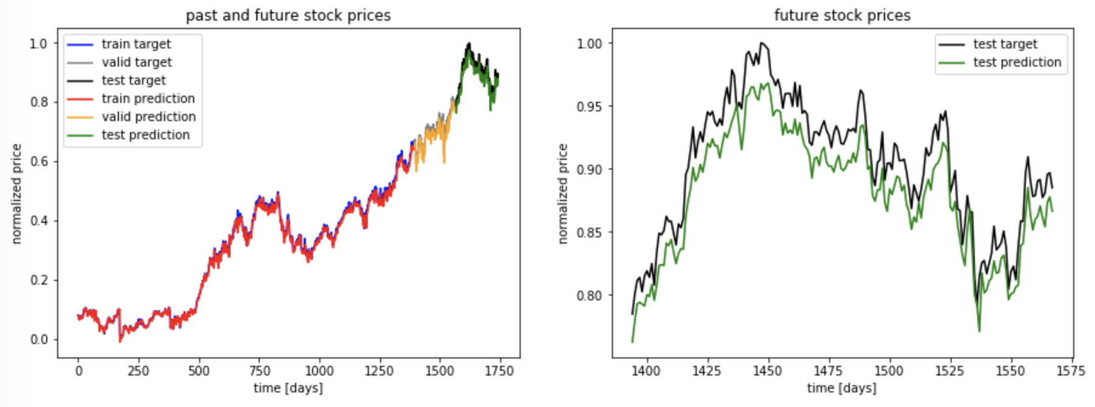
Predictions
Result

Slide 9

Thank You
2014097 Cho YoonSang

